Slide 1

BIG DATA
From knowing ‘what’ to understanding ‘why’?.
Decisions, Causality and All That…

Slide 2

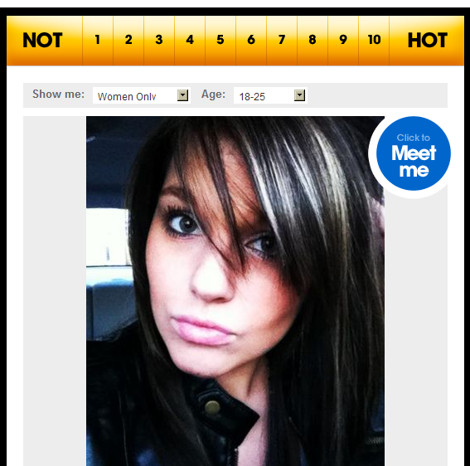



an important decision…
I think she is hot!
Hmm – so what should I write
to her to get her number?

Slide 3
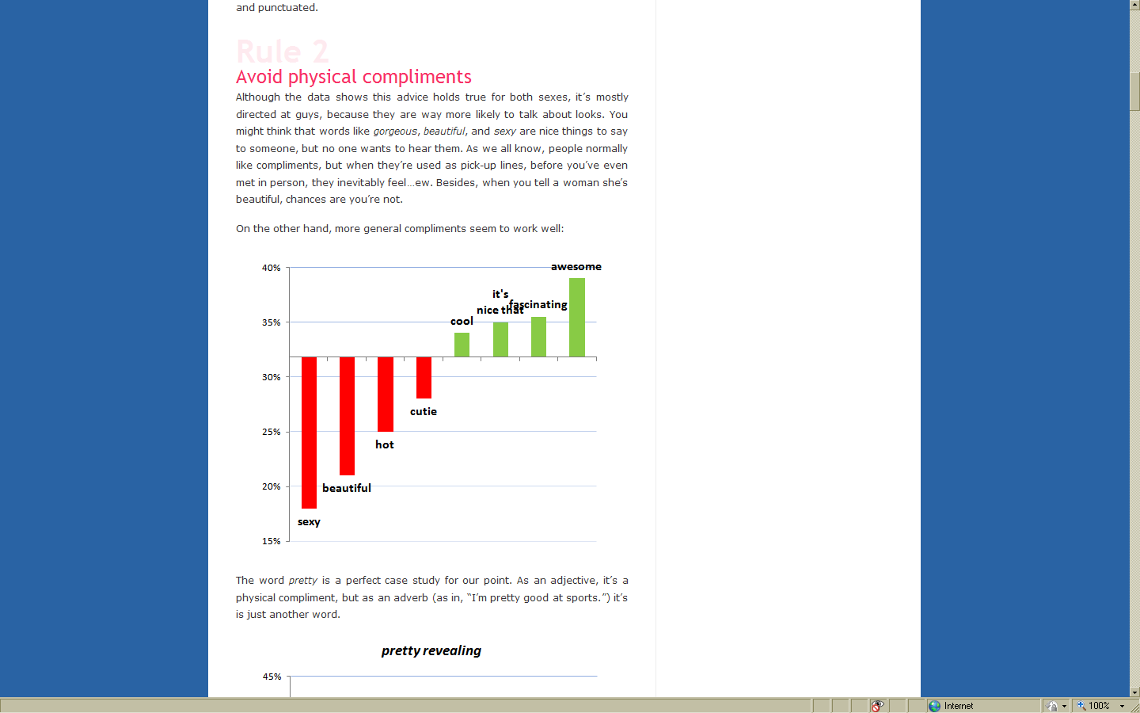

On the other hand, more general compliments work quite well.
The word pretty is a perfect case study for our point. As an adjective, it’s a physical compliment, but as an adverb (as in, “I’m pretty good at sports.”) it is just another word.
?
Source: OK Trends

Slide 4

hardships of causality.
Beauty is Confounding
  determines both the probability of getting the number and of the probability that James will say it
  need to control for the actual beauty or it can appear that making compliments is a bad idea
“You are beautiful.”

Slide 5
causal analysis in
online display advertising.
Notes:
[ALL PAGES EITHER NEED m6d logo on side or not, same with page numbers]

Slide 6

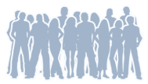











The life of a browser process.
1. Observe people taking actions and visiting content
2. Use observed data to build list of prospects
3. Subsequently observe same browser surfing the web the next day
4. Browser visits a site where a display ad spot exists and bid requests are made
5. Auction is held for display spot
6. If auction is won display the ad
7. Observe browsers actions
after displaying the ad
Notes:
Build a model on people taking actions. Surfing web next day. Hits a spot where an ad may be served. Bidding Process. Show an Ad. Then observe if they take an action. GET BID REQUEST.

Slide 7
what do advertisers want?
Conversions?
1.05X
1.11X
2.26X
0.92X
1.31X
2.62X
TELECOM COMPANY A
TELECOM COMPANY A
TELECOM COMPANY B
TELECOM COMPANY B
TELECOM COMPANY C
TELECOM COMPANY C
Notes:
Assessing the impact of the advertising it is clear that in these cases it is more advantageous to show advertisements to new prospects.
Compared to cost per conversion goals. ROI, Gross Conversion Rates.

Slide 8






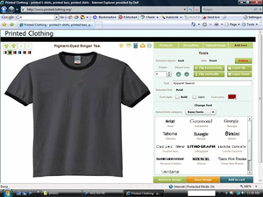
question of interest.
?
what is the causal effect of
m6d’s display advertising
on customer conversion?
display advertising
Showing/Not showing a browser a display ad.
customer conversion
Visiting the advertisers website in the next 5 days.
Notes:
[I like ? In middle, but it needs to be lightened up]

Slide 9
general approach.
?
1. Ask the right question
P
2. Understand/express the causal process
Ψ(P)
3. Translate question into a formal quantity
Ψ(P_{n})
4. Try to estimate it
Notes:
SEEMS LIKE AN OBVIOUS APPROACH.
SO RARELY FOLLOWED
EXAMPLE LOGISTIC REGRESSION. “I HAVE A BINARY OUTCOME, A BINARY TREATMENT LOGISTIC REGRESSION IS THE APPROACH”, “I HAVE A TIME DEPENDENT OUTCOME, COXPH REGRESSION”

Slide 10
?
1. state question.
What is the effect of
display advertising on customer
conversion?
display advertising
Showing/Not showing a browser a display ad.
customer conversion
Visiting the advertisers website in the next 5 days.

Slide 11


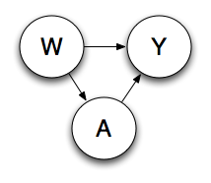
P
2. express causal
process.
“You are beautiful.”
O = (W,A,Y) ~ P₀
W – Baseline Variables
A – Binary Treatment (Ad)
Y – Binary Outcome (Purchase)
Notes:
This intervention distribution is a do calculus according to Pearl or a Gcomp formula according to Robins. Also introduce Q and g. Classical example of confounding in graphical model W causes both A and Y.
Define Consistency Assumption
No unmeasured confounders
Positivity Assumption

Slide 12








data structure: our viewers.
Color
Head
Shape
Sex
CHARACTERISTICS
(W)
TREATMENT
(A)
Ad
No Ad
CONVERSION
(Y)
No
Yes

Slide 13
Ψ(P)
3. define quantity.
additive impact
E[Y_{A=ad}] – E[Y_{A=no ad}]
relative impact
E[Y_{A=ad}]/E[Y_{A=no ad}]
Notes:
NEED TO FIX THIS SLIDE, INTRODUCE POTENTIAL OUTCOMES IN BETTER WAY. [NOTE WRITE OUT ADDITIVE IMPACT AND RELATIVE IMPACT.]

Slide 14
Ψ(P_{n})
4. estimate quantity.
A/B testing
Modeling Observational Data
Notes:
NEED TO FIX THIS SLIDE, INTRODUCE POTENTIAL OUTCOMES IN BETTER WAY. [NOTE WRITE OUT ADDITIVE IMPACT AND RELATIVE IMPACT.]

Slide 15











common approach: A/B testing.
Since we can not both treat and not treat the same individuals. Randomization is used to create “equivalent” groups to treat and not treat.
3.4 per 1,000
1.6 per 1,000

Slide 16
practical concerns. associated with doing A/B testing
Cost of displaying PSAs to the control (untreated group).
Overhead cost of implementing A/B test and ensuring that it is done correctly.
Wait time necessary to evaluate the results.
No way to analyze past or completed campaigns.
Notes:
Ask Brian What PSAs are?

Slide 17










non invasive causal estimation (NICE).
Estimate The Effects In The Natural Environment (Observed Data)
Notes:
Red people don’t convert so unlikely to see ad. Blue and Grey with round heads are good converters so more likely to see advertisements.

Slide 18





“what if” causal analysis adjusting for confounding
Need to adjust for the fact that the group that saw the advertisement and the group that didn’t may be very different.

Slide 19
estimation – a primer.
When can we estimate it? Necessary conditions:
  no unmeasured confounding
  experimental variability/positivity
Be VERY careful with data collection
  Define cohorts and follow them over time
Estimation techniques
  Unadjusted
  Adjust through g_{A}
  MLE estimate of Q_{Y}
  Double robust combining g_{A} and Q_{Y}
  TMLE
Many tools exist for estimating binary conditional distributions
  Logistic regression, SVM, GAM, Regression Trees, etc.
g_{A}
P(W) P(A|W) P(Y|A,W)
Q_{W}
Q_{Y}

Slide 20
summary results.
median relative lift of 90%

Slide 21
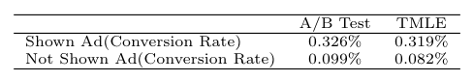
method validation:
A/B Test vs. analytic estimate

Slide 22
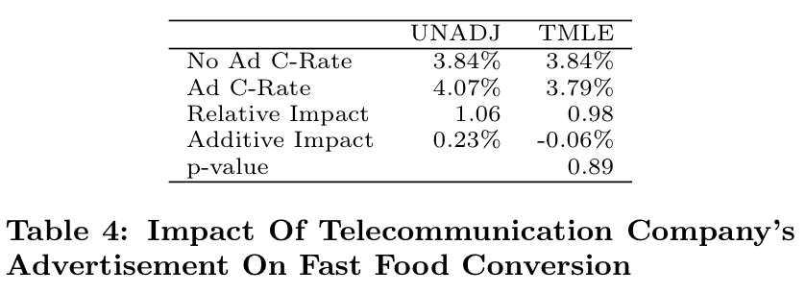
method validation: negative test
Impact of Telecommunication company’s advertisement on fast food conversion
Notes:
check for unmeasured confounding

Slide 23


gross conversion rates.
Additive Impact
-0.2%
TELECOM COMPANY A
TELECOM COMPANY B
TELECOM COMPANY C

Slide 24

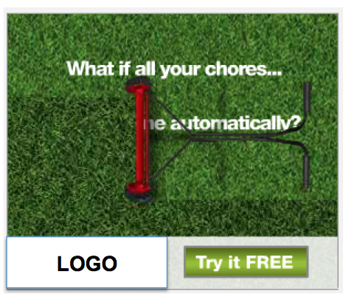

effectiveness varies by marketer.
1.08X
3.77X
B2B COMPANY A
4.23X
1.08X
B2B COMPANY A
B2B COMPANY B
B2B COMPANY B

Slide 25


creative matters.
NO LIFT
Brand is buried; sweepstakes, not the brand, is the primary message
NO LIFT
Call to action is inconsistent with primary message
This campaign drove no significant lift from either retargeting or new customer prospects, likely due to ineffective creative.

Slide 26
references.
O. Stitelman, B. Dalessandro, C. Perlich, and F. Provost. Estimating The Effect Of Online Display Advertising On Browser Conversion. In Proceedings of KDD, Annual International Workshop on Data Mining and Audience Intelligence for Online Advertising, ADKDD ’11.
M. van der Laan and S. Rose. Targeted Learning: Causal Inference for Observational and Experimental Data. New York, NY: Springer Publishing Company, 2011. http://www.targetedlearningbook.com/
‘tmle’ R Package http://cran.r-project.org/web/packages/tmle/index.html
R. Kohavi and R. Longbotham. Unexpected results in online controlled experiments. ACM SIGKDD Explorations Newsletter, 12(2):31–35, 2010.
R. Lewis and D. Reiley. Does retail advertising work: Measuring the effects of advertising on sales via a controlled experiment on yahoo. Technical report, Working paper, 2010.
D. Chan, R. Ge, O. Gershony, T. Hesterberg, and D. Lambert. Evaluating online ad campaigns in a pipeline: causal models at scale. In Proceedings of KDD, KDD ’10, pages 7–16, New York, NY, USA, 2010. ACM.
Claudia’s Office Hours:
Thursday 2:20 PM
Exhibition Hall
Data Science Team:
Ori Stitelman
Brian Dalessandro
Troy Raeder
Charlie Guthrie
Foster Provost
Notes:
Add talk on KDD WORKSHOP [CAN YOU FORMAT NICER]

